Slide 1



TAMPERE GOES AGILE 2017
But I want the team to be X times faster!

Slide 2
WHO, ME?
Mika Turunen- @mikaturunen
CTO – Checkout Finland Oy
Team lead by day, architect and a developer by night.
Come say hi after this ☺
Notes:
Backgrounds, different companies and the normal jargon
Different approach to `Alternatives to Established Agile Approaches`, actually finding your own way and just figuring it out through iteration, picking and choosing the best sides of different practices

Slide 3
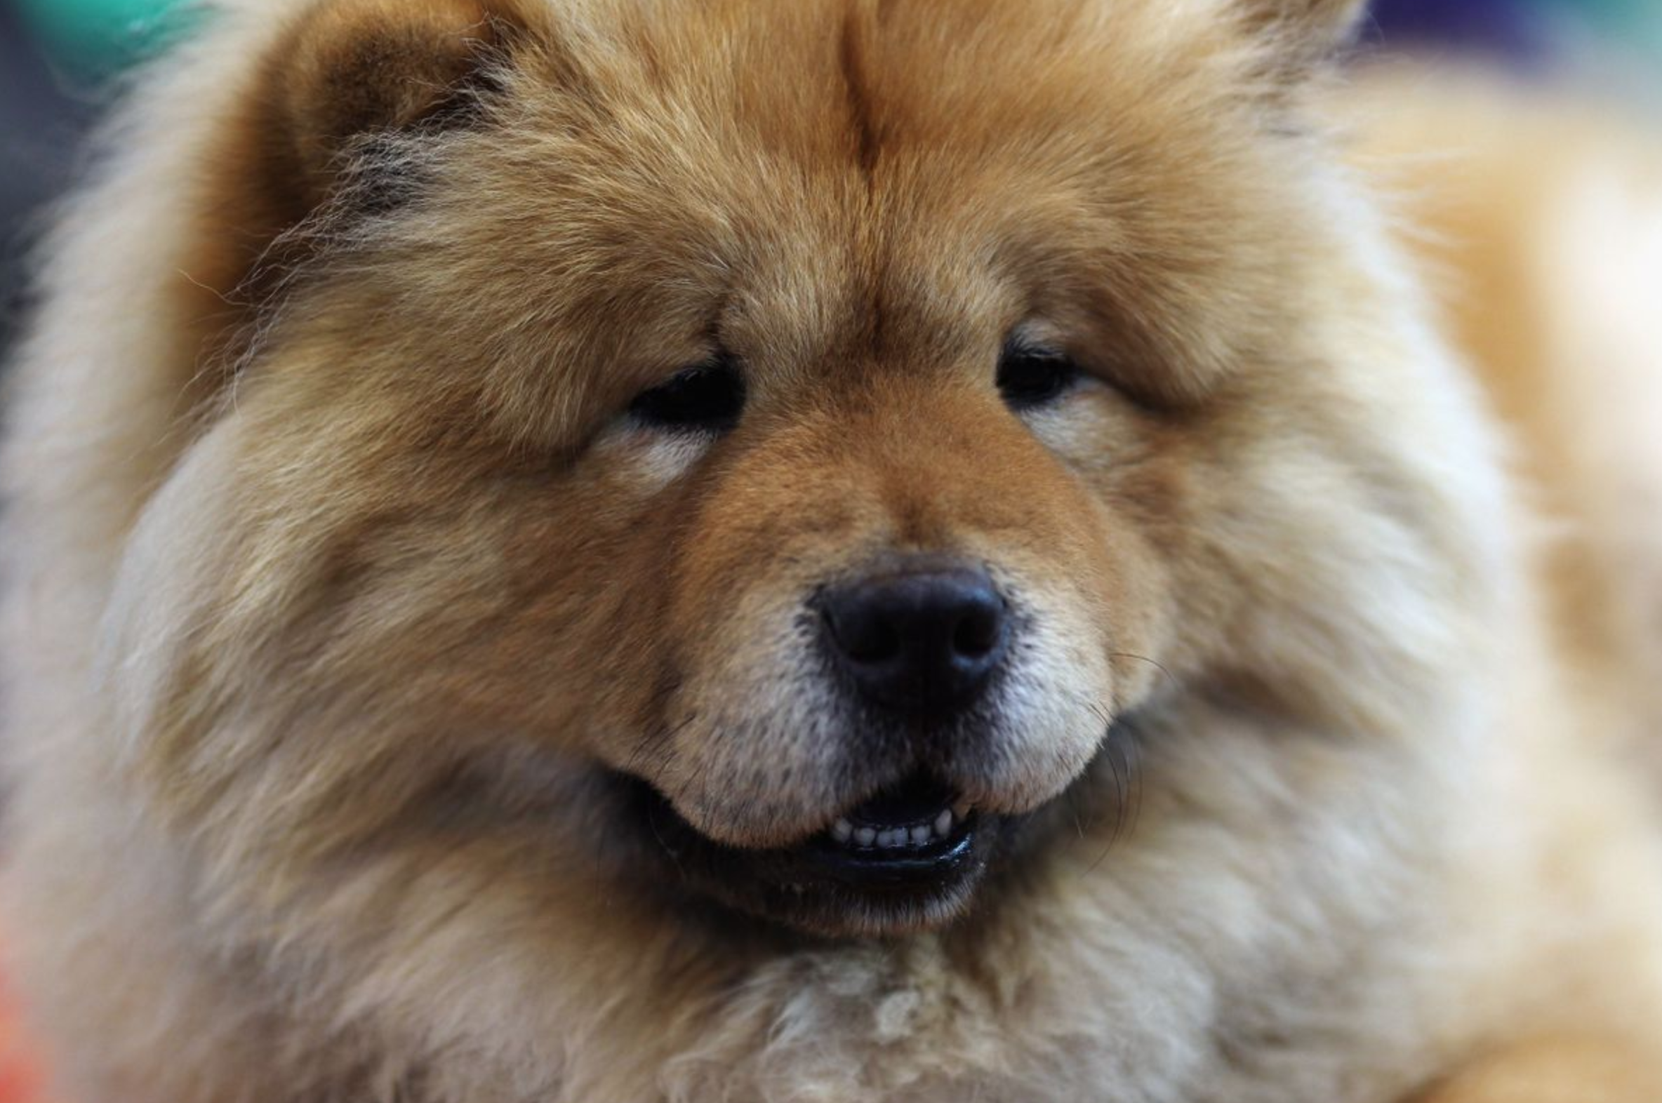
STORY REPEATS ITSELF, THE WAY IT HAPPENS CHANGES.
* If you don’t like the content, you should at least like the images. Don’t worry, cat people are catered too.
Notes:
1. STORY: Set the stage for the story --- tell of team, struggle and absolutely insane misunderstandings coming from this setting
Story of a team that was forgotten - more a story of leading a team in general, the team in question just happens to be a developer team
Background:
Challenges in organisations that are turning into service business’
Teams, operations, development, running everything
Exactly this is the reason why it’s so important that events like the Tampere Goes Agile 2017 are held and professionals take part
What it used to be (doing wise) vs what it is now
A wild team appears and the idea of how do we actually get the team moving also emerges
For whatever historical reasons the team is not functioning as it should
Someone hands the reigns to you of the team, take care of them and with assumed magic, make the team fast! “I heard they do this and that at Spotify so it must be working”.
Issues usually pop up based on assumptions and misunderstanding of what you are trying to do
Seen by a miracle maker by the high-ups and a slave driver by the team

Slide 4

THE TEAM. SE7EN PEOPLE STUCK IN A LIMBO.
* see, cats!
Notes:
2. TEAM: Tell of the team, describe their struggle and how they were forgotten. Tell of leader vulnerability.
Team
Divided but yet stuck together, track record of no real releases to mention, not the teams fault
They were stuck in a limbo for a long time and nobody was there to look after them
I was seen as the bad guy, someone who came in and wanted to break it all
Few saw this as an opportunity and possibility for a good change
Leader qualities
Allow them to see you being less-than-perfect, you’re just human after all
Struggles of throwing away the bad guy chains
Actual stories
Stories of horrible server mutations, production changes and live-programming
No deployment pipeline to name
God knows when was the last time everything was updated

Slide 5
HOW DID THE CHANGE START?
I ran out of pictures…
Notes:
3. TEAM+PROCESS: Change can only happen when everyone want it – mention: initial process’, attitudes, timing issues, constant rush
General
Physically make room to discuss with all the members, just talk talk and talk more
Listen to the team but beware, if the environment is not right, you might be misguided
Snake in the garden effect
Team
Not as much about me telling them how to work
More about allowing them to have the space to grow into the role and figure out what is wanted from them
Start small: few successes with different team members, start building trust -- harder to betray and few start seeing you as a good guy, they start changing everyones opinion in the team
Information
Tell of the pitfalls — micro-managing miracles
Not about choosing a specific mold, more about finding the way as a team and figuring it out as you go. Start defining minimal amount of process’ and practices to survive day to day lives.

Slide 6
STEPS TAKEN
Kanban
Lean
Agile
..wait, what, huh?
Voodoo
Scrum
Scrumban
Magic
Notes:
4. PROCESS: actual steps, go into detail of how we started to figure things out
Once we had the basics in place, we wanted to succeed so badly. It was supposed to be easy!
Started with structures kanban, moved to scrum and attempted few others
Autonomity
Stories to get the team involved — why are we doing what we do instead of mindless drones
Once the team understand why we are doing something, the whole thing starts turning into fairly autonomous team that runs itself.
Stop feeding the stories, lose the autonomy of the team
We still at times struggle with this due to me being too busy - that’s completely on me
Tooling and process
It really doesn’t matter what tools you use, we went with the Atlassian family, to name a few
Keep it simple and cut the unnecessary — it applies to process’ too but not with the excuse of cutting out the proccess’ complete. Some of them serve an excellent purpose and leave you for more time to actually focus on your core values
it’s not about hitting it off perfectly from the start, just keep iterating and finding your way
Allow the team to guide every now and then
Lead by example, show the team, get involved
We did a lot of mistakes new features vs critical legacy bugs
Different type of memberes, first 90% and last 10%
Lead type, bug fixed etc
Why is a diverse team a strength?
It’s actually okay to pick-and-choose from best practices

Slide 7
FEEDBACK, THERE WILL BE FEEDBACK…
Notes:
Even if it goes well, the people that don’t understand what you’re trying to do and just look at the initial performance will give you not so pleasant feedback
Explain, show, lead

Slide 8
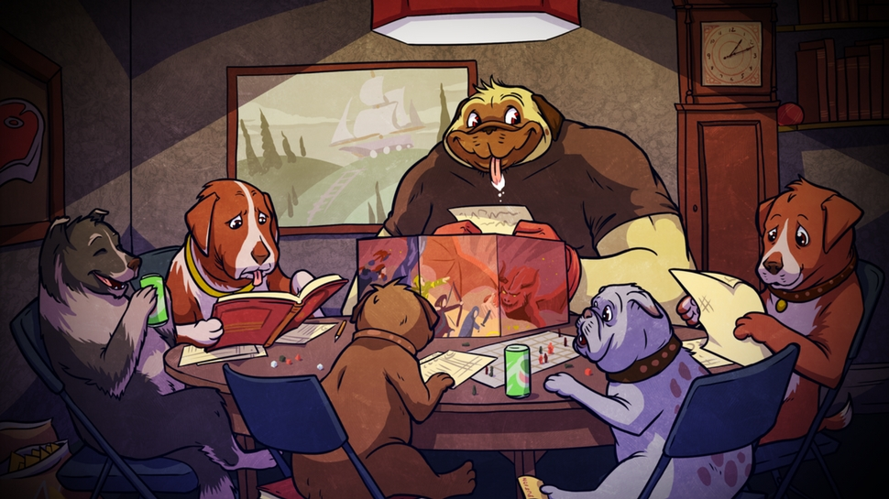
GENTLY GUIDE THE ADVENTURING PARTY.
Notes:
5. FORGING STRONG BOND WITH TEAM: tell of the changes you’ve done, the discussions you’ve had and the lengths you’ve gone for the team
It’s the small things
Sit with the team, be close to them, be available.
You cannot do good in your job if you are not present for them – good leader is present and available
It can work remotely, really well in fact, but it first requires you have a running team
It’s easier to get going when you’re physically available
Teach them the importance of retrospectives - look back, look forward. Retro + Future. It’s important to try and learn.
In this position, the team is your set of tools, make sure they are as sharp as possible
In lead positions it’s not always your specific tech knowledge that makes or breaks it, it’s the way you lead and treat people
Take pride in the team, never sacrifice any team members to the fire, be the shield they need you to be so they can focus on the work they do
Even when you’re suffering from growing pains, keep it up, keep your heads tucked in

Slide 9
“BUT I WANT THE TEAM TO BE X TIMES FASTER. USE THIS AGILE X TRICK I READ FROM A BLOG POST!”
- Unknown Overlord
Notes:
Once you finally start getting the ball rolling, someone from somewhere will appear like a troll under the bridge and throw this at your face..
Believe me, it always seems like the grass is greener on the other side of the fence but in fact they’re doing exactly the same thing — Then there’s these magic houses like Spotify, Netflix and what not. Most of us will do super good with knowing the basics and doing them really well.
Don’t allow the people to get into agile-frenzy, it’s all about keeping it simple and discussing the details
Keep calm, keep iterating, keep it simple

Slide 10
MOVE PEOPLE!
Get people attending, learning and involved.
Notes:
6. Backgrounds in forging a good team and getting everyone on the same page.
Exactly the reason why TRE agile is an important event
Get higher ups attending, make them learn and understand
The more knowledge there is, the easier it is to make room for time to potentially be better in the future
If there’s no time arranged for change, we cannot make change happen - change takes time!

Slide 11
KNOW YOUR BASICS
Notes:
7. NO MAGIC SAUCE – HARD WORK, DEDICATION AND TEARS!
There is no magic sauce available, it’s pure hard work.
Know your basics, repeat them, get better at them and iterate.
Keep the iterations small to be able to quickly learn from mistakes and success’
When you’ve done something a million times, from practices point of view, you’ll do it really well and really quickly
Being fast doesn’t always mean you’re doing things the way; for example, Spotify does - though sometimes it might mean :)

Slide 12
LESSONS LEARNED? THE ACTUAL TAKE AWAY?
Notes:
8. TIE BACK TO THE BEGINNING, I WANT THE TEAM TO BE X TIMES FASTER
Extreme speed is just repetition and repetition, over and over, knowing your basics REALLY WELL.
It’s less about my personal experience with X technology and more about making sure the tools are as sharp as they can be.
..or with field Y
Sharpen the tools in the toolbox!
Change takes time. Often, a lot of it.
Make time.

Slide 13

THANK YOU! @MIKATURUNEN

